Slide 1
Projektas
Kalėdiniai sveikinimai
Užduotys atliktos SCRATCH aplinkoje

Slide 2
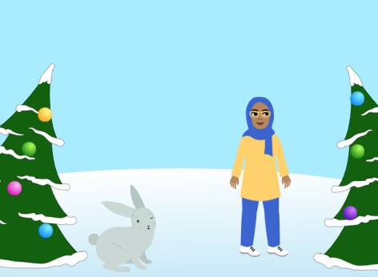
Augustė Ribinskaitė, 2b
https://scratch.mit.edu/projects/783617045/fullscreen/

Slide 3
Augustas, 3a
https://scratch.mit.edu/projects/783618418/fullscreen/

Slide 4
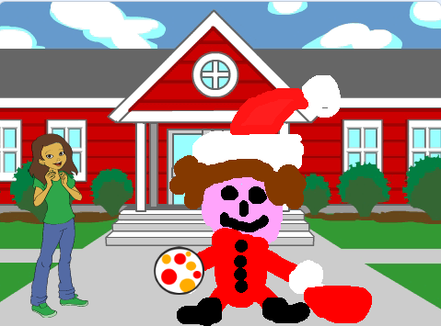
Arijielius, 2b
https://scratch.mit.edu/projects/783618905/fullscreen/

Slide 5
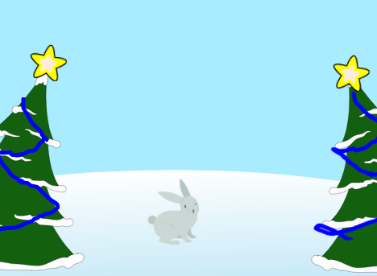
Rugilė Ribinskaitė, 5a
https://scratch.mit.edu/projects/783620627/fullscreen/

Slide 6
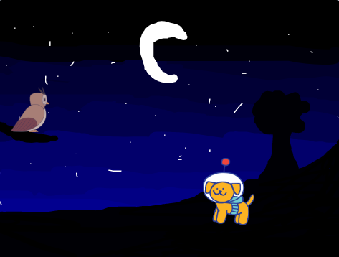
Rugilė, 4
https://scratch.mit.edu/projects/783620054/fullscreen/

Slide 7
Gabrielė, 2b
https://scratch.mit.edu/projects/783621259/fullscreen/

Slide 8
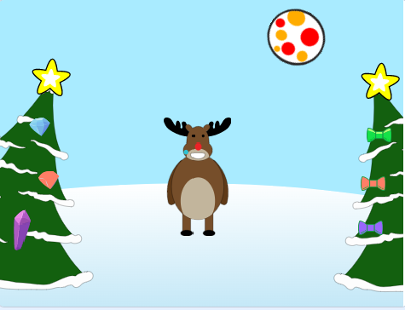
Saulė, 3a kl.
https://scratch.mit.edu/projects/783622036/fullscreen/

Slide 9
Arminas, 2a
https://scratch.mit.edu/projects/783622930/fullscreen/

Slide 10
Arminas, 2b
https://scratch.mit.edu/projects/783623972/fullscreen/

Slide 11
Ugnė ir Rugilė, 2a
https://scratch.mit.edu/projects/783624392/fullscreen/

Slide 12
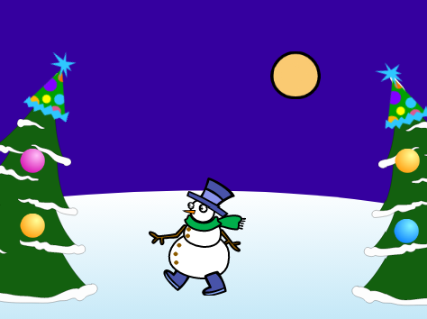
Deimantė, 2b
https://scratch.mit.edu/projects/783624991/fullscreen/

Slide 13
Augustė ir Paulina, 3a
https://scratch.mit.edu/projects/783631489/fullscreen/

Slide 14
Martynas, 2b
https://scratch.mit.edu/projects/783632249/fullscreen/

Slide 15
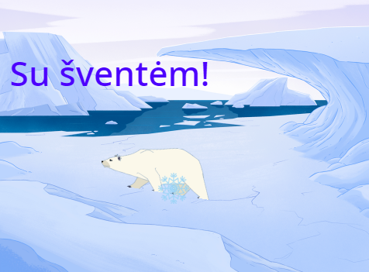
Domantas, 2b
https://scratch.mit.edu/projects/783632738/fullscreen/

Slide 16
Irūna, 4a
https://scratch.mit.edu/projects/783633177/fullscreen/

Slide 17
Majus, 2a
https://scratch.mit.edu/projects/783633644/fullscreen/

Slide 18
Ajus, 2b
https://scratch.mit.edu/projects/783634110/fullscreen/

Slide 19
Vakarė, 4
https://scratch.mit.edu/projects/776797582/fullscreen/

Slide 20
Emilija ir Akvilė, 3a
https://scratch.mit.edu/projects/776792293/fullscreen/

Slide 21
Austėja, 4a
https://scratch.mit.edu/projects/617588208/fullscreen/

